Slide 1

Marijuana Strain Suggester
By: Nolan Whitehead

Slide 2
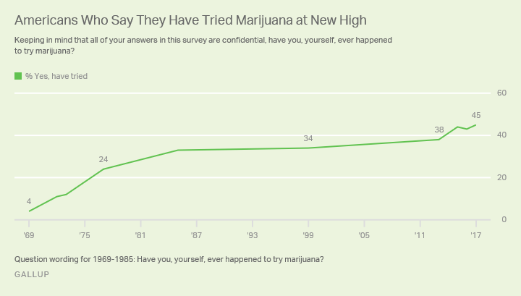
Marijuana Use is on the Rise
Admitted marijuana use has been on the rise since the late 60s.
Despite a relative flatline since the mid 80s, there has been a clear boom in the 2010s.
This stat is the number that have tried, not the number that were current smokers at the time.

Slide 3
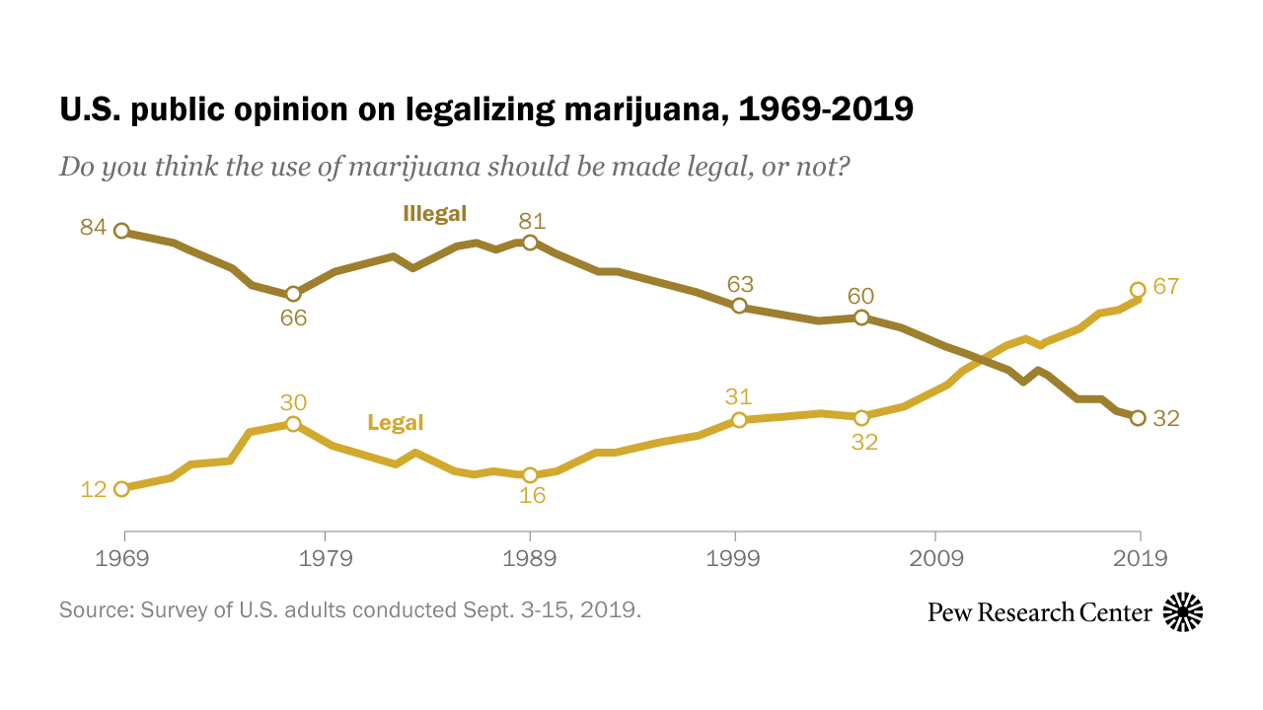
Support for Legalization Skyrocketing
Despite the efforts of many politicians, support for legalization has recently broken 2/3 of American adults.
The increase has been constant since the mid 2000s and is showing no signs of slowing.

Slide 4
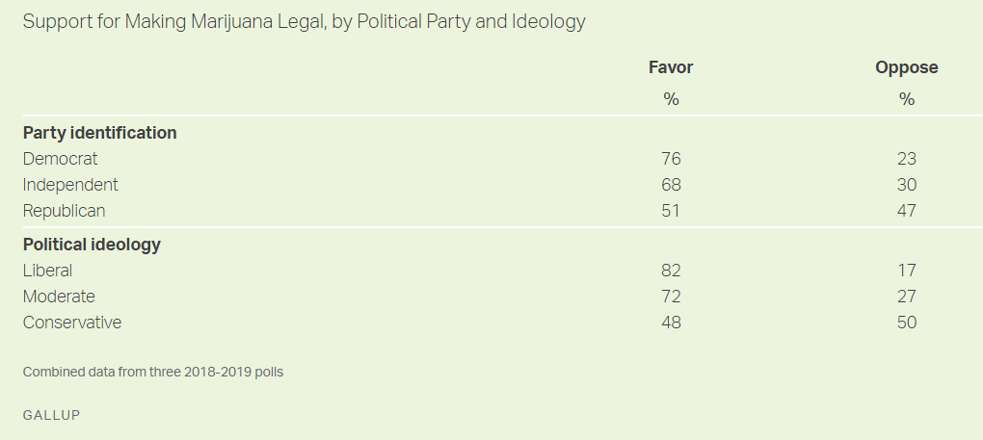
Legalization Crosses Party Lines
But not quite ideological lines.

Slide 5
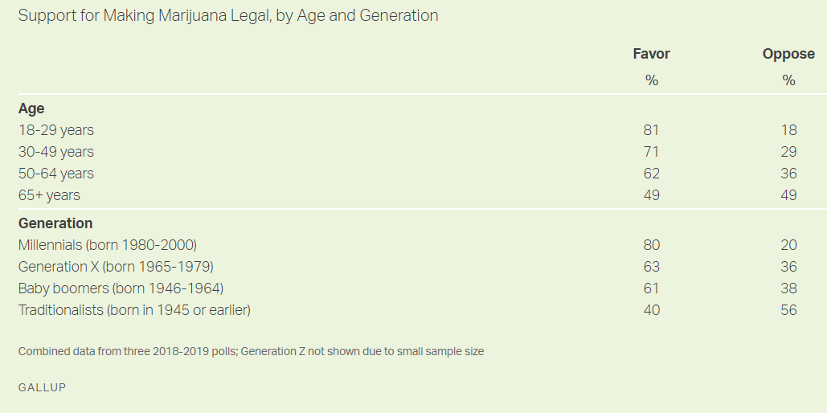
Even the Boomers are Ok With It
And I’m not apologizing for that joke.

Slide 6
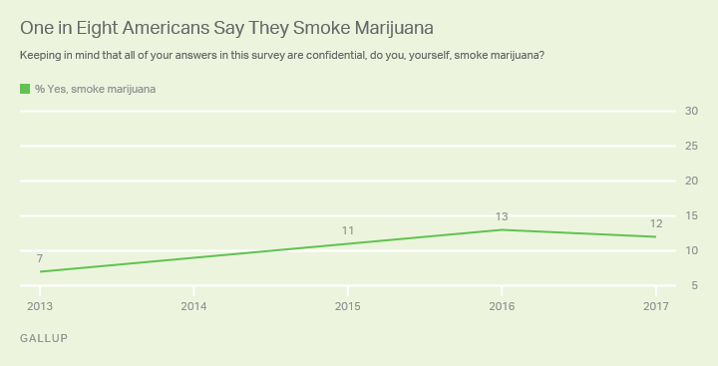
Percent Active Users Still Low
As of this 2017 Gallup poll, only 1 in 8 American adults admitted to being current smokers.
While this has likely gone up in the past few years, it is unlikely that it has reached the 67% that currently support legalization.

Slide 7
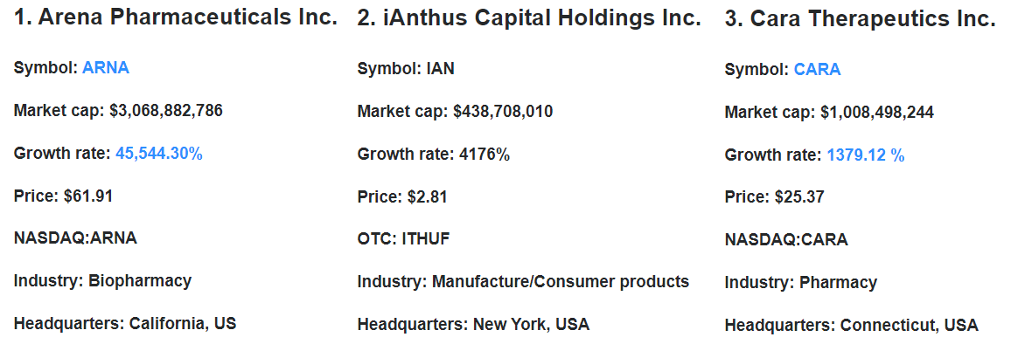
Major US Companies are Already Joining the Industry
The 3 fastest growing marijuana companies in the world, according to Yahoo Finance are all United States based companies with growth rates above 1000%.

Slide 8
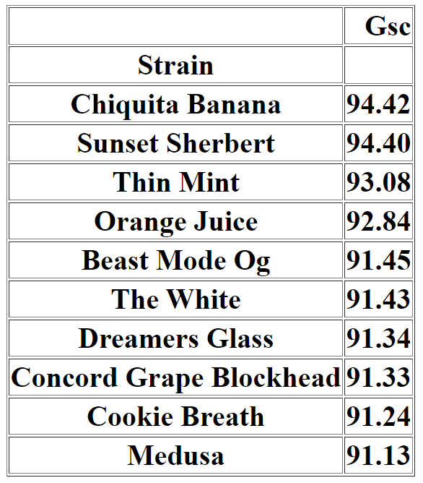
So How Do We Enter The Industry
I have created a prototype for an unsupervised machine learning algorithm that can suggest similar strains to a strain of the user's choice.
The algorithm looks at details ranging from the type (Indica, Sativa, Hybrid), medical uses (Insomnia, Pain, Anxiety, etc.), effects (Sleepy, Uplifted, etc.), Parent Strains, and other keywords I was able to extract from the description column of the dataset I found.
The end goal is to market this algorithm to a company like Leafly, which not only has access to better data than the set I used, but also has a great platform through which to get this app to the public.

Slide 9
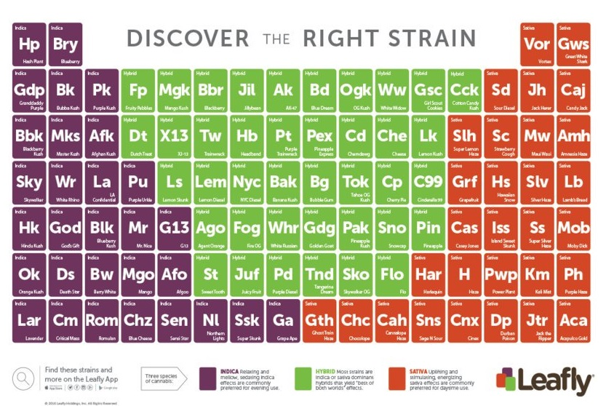
Why Leafly?
Leafly is an app and website that allows users rate and review different strains of marijuana, whilst also providing information on like THC content and lineage.
They dataset that they have access to is larger, more accurate, and more constantly updated than any we would otherwise have access to.

Slide 10
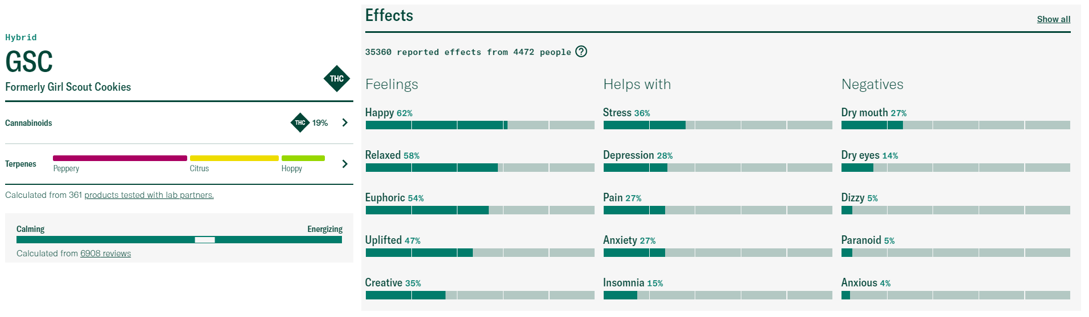
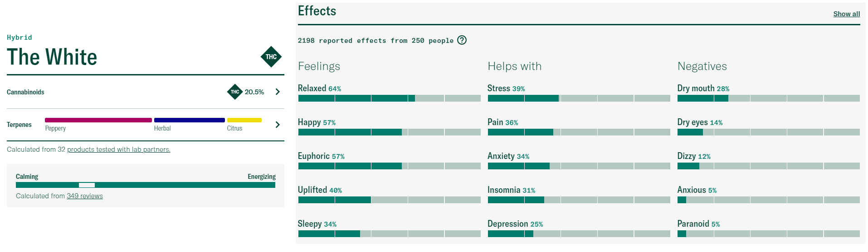
I used Leafly to Check the Accuracy
GSC, formally known as Girl Scout Cookies, was the first strain that I ran to test the algorithm, and The White was the 6th closest match.
They share 4 of the 5 listed Feelings with close percentiles and 5 of 5 for both Helps With and Negatives with all but Insomnia being within 10%.
THC and CBD contents were also very close, and the Terpenes (flavors) were similar as well.

Slide 11

Gambling Time
We’re gonna do a live test now.
I need a strain suggestion from someone in class, and we’re going to check if Leafly agrees.

Slide 12


